Slide 1
통계 및 실습 review #1

Slide 2
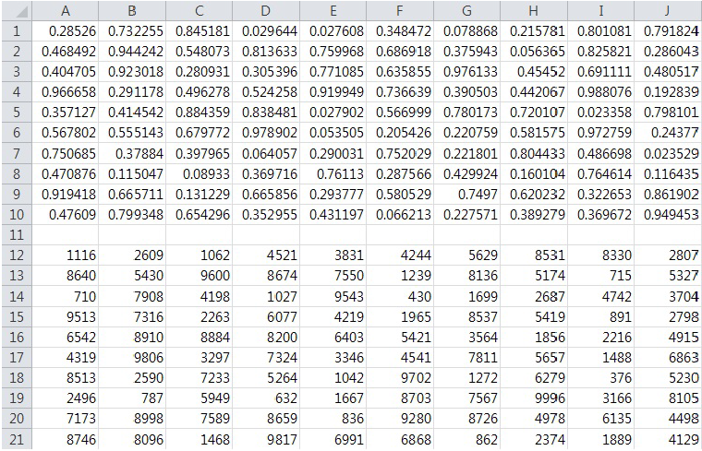
Excel
- What is the command used to get the random data?
+RAND()
+RANDBETWEEN(bottom, top)
- What is the values and command used to get values for the this data?
+MAX(A1:J10)
Max :
Min :
Average :
Standard Deviation :
Variance :
Median :
Range :
+MIN(A1:J10)
+AVERAGE(A1:J10)
+STDEV(A1:J10)
+VAR(A1:J10)
+MEDIAN(A1:J10)
+MAX(A1:J10)-MIN(A1:J10)

Slide 3

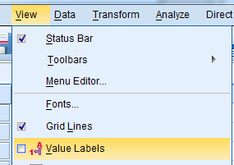
SPSS
1. 데이터 입력
(1) 직접 입력
① Variable View에서 Name, Type, Decimals, Label, Values, Measure 등을 정의한 후 Date View에 데이터를 입력
- Name, Label : Name은 띄어쓰기 불가능 · ‘_’ 등으로 대체, Label은 띄어쓰기 가능
- Type : String(문자) / Numeric(숫자(값))
- Decimals : 소수점 자릿수
- Values : coding scheme -> 반드시 Type : Numeric, Measure : Ordinal / Nominal
View – Value Labels 항목 체크를 통해 values 값 확인
- Measure : Scale(ex) 키, 점수) /
Ordinal(ex) 학점) /
Nominal(ex) 성별)
※ 원하는 그래프 또는 테스트를 진행하기 위해서는 반드시 올바른 Type과 Measure로 정의되어 있어야 한다!

Slide 4
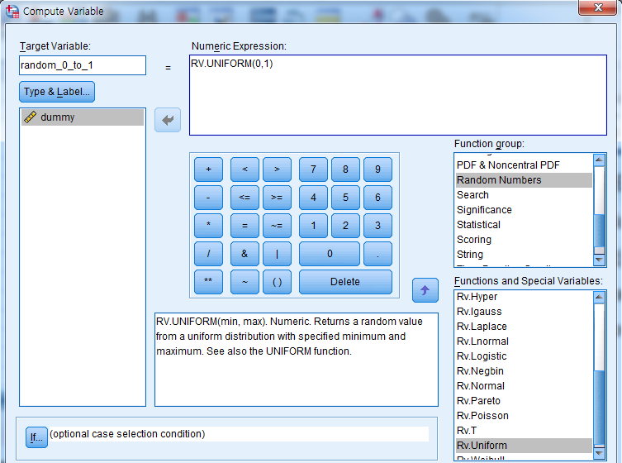
SPSS
1. 데이터 입력
(2) Random number 생성
- 몇 개의 random number를 생성할 것인지 정하기 위해 dummy variable를 정의 후 생성할 random number의 수만큼 data 입력
- Transform – Compute Variable
- Function group:
-> Random Numbers
Functions and Special Variables:
-> Rv.Uniform
- 범위(최소값, 최대값) 설정
- Random number 생성 후
dummy variable 제거
※ 사람마다 생성되는 random number가 다르니 생성하는 방법까지만 알아둔다.

Slide 5
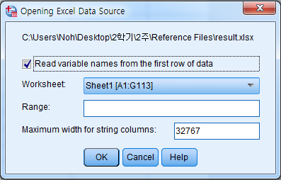
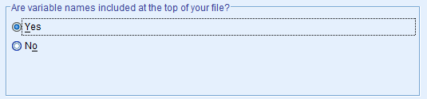
SPSS
1. 데이터 입력
(3) 엑셀파일/텍스트파일 Import
① 엑셀파일 Import
- File - Open - Data - Files of type : Excel
- 엑셀파일의 첫번째 행이 Variable Name이면 Read variable names from the first row of data 항목 체크
② 텍스트파일 Import
- File - Open - Data - Files of type : Text
- Step 2에서 텍스트파일의 첫번째 행이 Variable Name이면 Are variable names included at the top of your file? 항목을 Yes로 변경
※ 원하는 그래프 또는 테스트를 진행하기 위해서는 반드시 올바른 Type과 Measure로 재정의해야 한다.

Slide 6
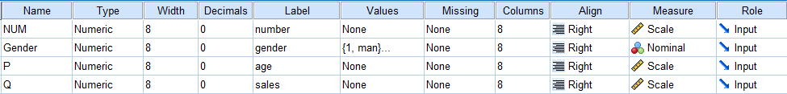
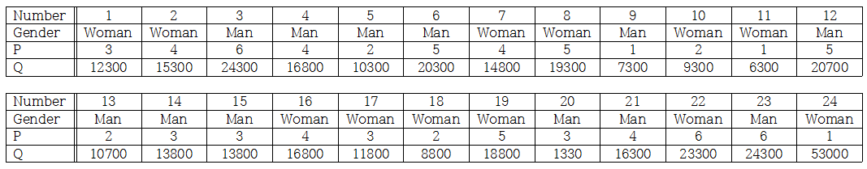
SPSS
2. 분석
(1) Data 입력
아래 data를 입력
파일이름: data

Slide 7
SPSS
2. 분석
(2) Normality
- What is the name of test to check normality?
Histogram
P-P plot
Q-Q plot
Kurtosis/Skewness test
Kolmogorov-Smirnov & Shapiro-Wilk test

Slide 8

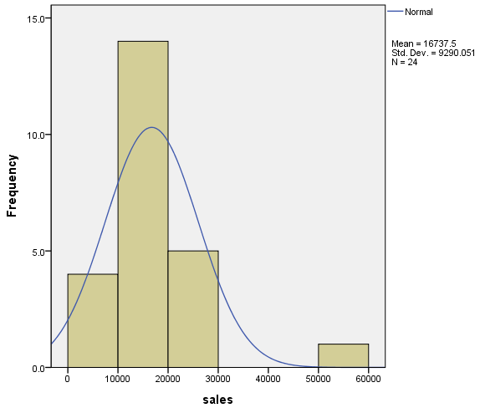
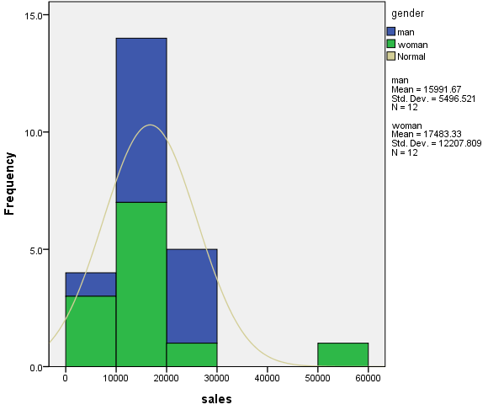
SPSS
2. 분석
(2) Normality
① draw Histogram(+Normal Curve) on the sales(Q) variable
Graphs - Chart Builder - Histogram (Display normal curve 체크 & Apply)
Simple Histogram Stacked Histogram (based on the Gender)
Is ‘sales’ a normal distribution? Why?
=> Not Normal because there is an outlier

Slide 9
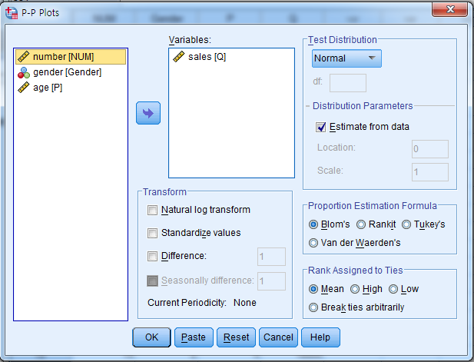
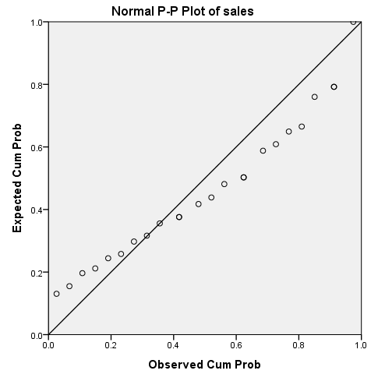
SPSS
2. 분석
(2) Normality
② draw P-P plot on the sales(Q) variable
Analyze – Descriptive Statistics - P-P Plots
Is ‘sales’ a normal? Why?
=> Not Normal because all the data points are not near to the reference line.

Slide 10
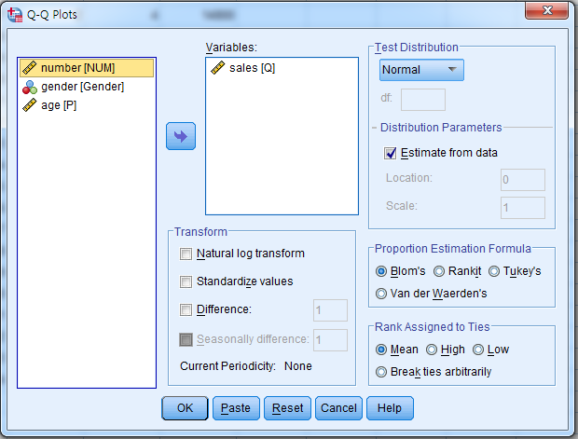
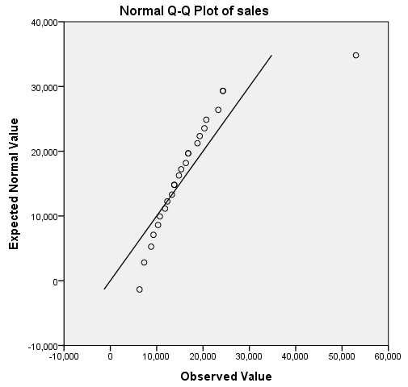
SPSS
2. 분석
(2) Normality
③ draw Q-Q plot on the sales(Q) variable
Analyze – Descriptive Statistics - Q-Q Plots
Is ‘sales’ a normal? Why?
=> Not Normal because all the data points are not near to the reference line.

Slide 11
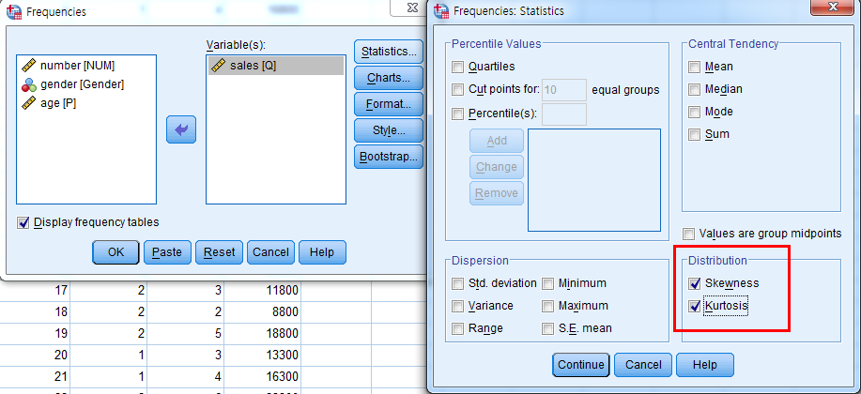
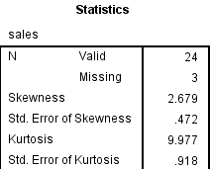
SPSS
2. 분석
(2) Normality
④ Kurtosis/Skewness test on the sales(Q) variable
Analyze – Descriptive Statistics – Frequencies
Statistics – Skewness, Kurtosis 체크
Is ‘sales’ a normal? Why?
=> Not Normal because the values for skewness(2.679) and Kurtosis(9.977) are far from 0

Slide 12
SPSS
2. 분석
(2) Normality
⑤ Kolmogorov-Smirnov & Shapiro-Wilk test on the sales(Q) variable
null and alternative hypotheses :
H₀: Normality can be assumed
H₁: Normality can’t be assumed

Slide 13
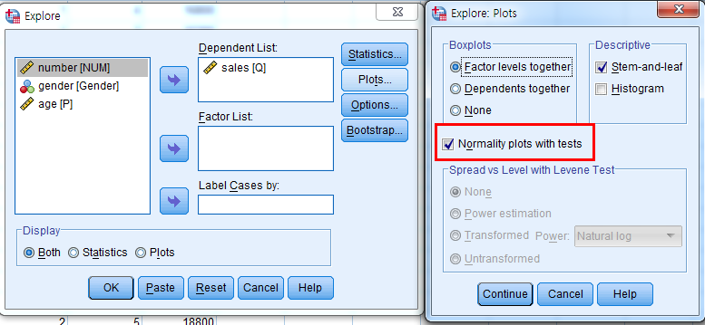
SPSS
2. 분석
(2) Normality
⑤ Kolmogorov-Smirnov & Shapiro-Wilk test on the sales(Q) variable
Analyze – Descriptive Statistics – Explore
Plots – Normality plots with tests 체크

Slide 14
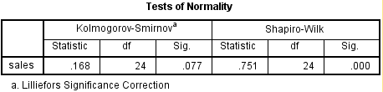
SPSS
2. 분석
(2) Normality
⑤ Kolmogorov-Smirnov & Shapiro-Wilk test on the sales(Q) variable
Is this normal distribution?
No!
Shapiro-Wilk test is more powerful than K-S test.
So, We should use Shapiro-Wilk test result to interpret this data.
K-S test Shapiro test
< 0.5 < 0.5 We should use K-S test
> 0.5 > 0.5 We should use K-S test
< 0.5 > 0.5 We should use Shapiro test
> 0.5 < 0.5 We should use Shapiro test

Slide 15
SPSS
2. 분석
(2) Normality
⑤ Kolmogorov-Smirnov & Shapiro-Wilk test on the sales(Q) variable
null and alternative hypotheses :
H₀: Normality can be assumed
H₁: Normality can’t be assumed
Interpret :
Shapiro test
D(24) = 0.751, sig = 0.000(<0.05)
This test is significant.
Reject H₀.
Conclusion : Sales is not a normal distribution.
각 Test마다 쓰는 기호 다르니
이점 주의할 것!

Slide 16
SPSS
2. 분석
(2) Normality
⑤ Kolmogorov-Smirnov & Shapiro-Wilk test on the sales(Q) variable
One of the data in sales variable is incorrect.
Identify and modify the incorrect value.
어떤 데이터가 incorrected data(outlier)인지 분석
=> Boxplot 이용(outlier 데이터 번호 확인 가능함)

Slide 17
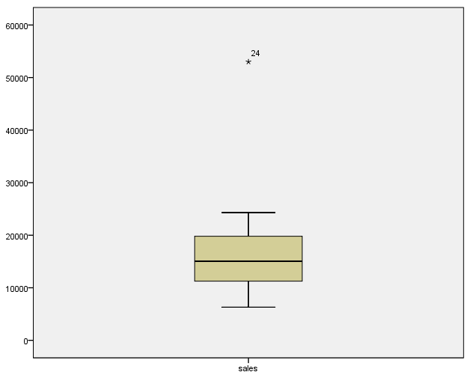
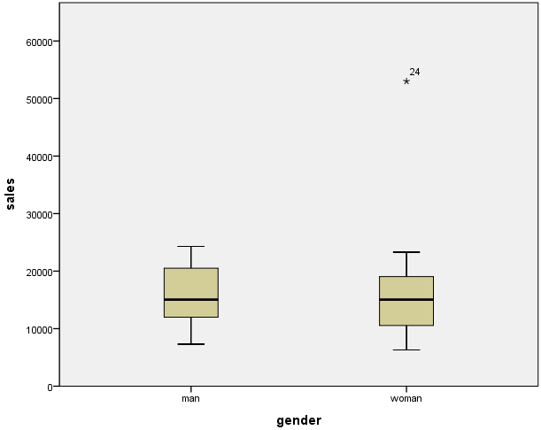
SPSS
2. 분석
(2) Normality
⑤ Kolmogorov-Smirnov & Shapiro-Wilk test on the sales(Q) variable
Graphs - Chart Builder - Boxplot
Boxplot Boxplot (based on the Gender)
* : outlier일 확률이 90% 이상이다. / o : outlier인지 확신할 수 없다.

Slide 18
SPSS
2. 분석
(2) Normality
⑤ Kolmogorov-Smirnov & Shapiro-Wilk test on the sales(Q) variable
24번 데이터 53000을 5300으로 변경!

Slide 19
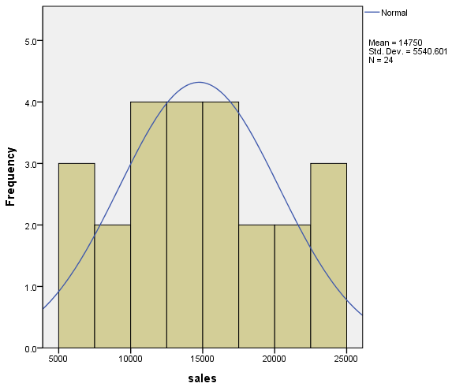
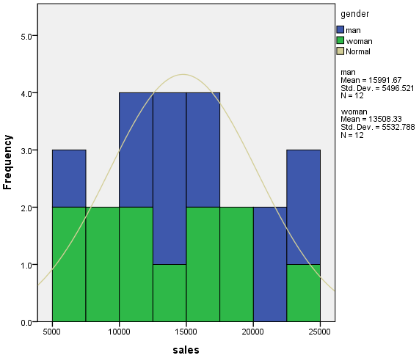
SPSS
2. 분석
(2) Normality
⑤ Kolmogorov-Smirnov & Shapiro-Wilk test on the sales(Q) variable
Simple Histogram Stacked Histogram (based on the Gender)
변경전
변경후
=> Approximately Normal

Slide 20
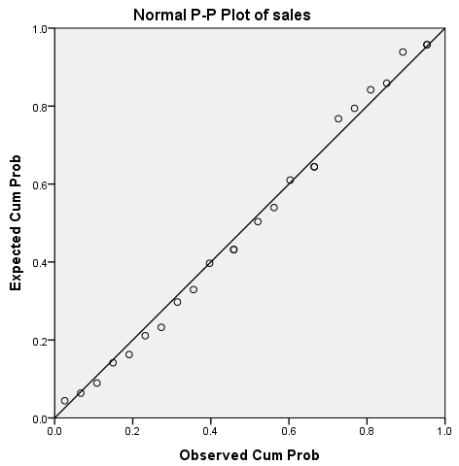
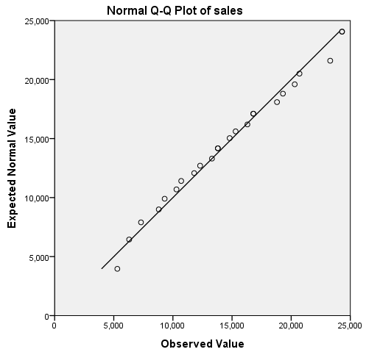
SPSS
2. 분석
(2) Normality
⑤ Kolmogorov-Smirnov & Shapiro-Wilk test on the sales(Q) variable
P-P plot Q-Q plot
변경전
변경후
=> Approximately Normal because all the data points are near to the reference line

Slide 21
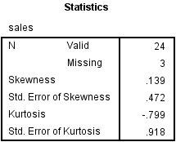
SPSS
2. 분석
(2) Normality
⑤ Kolmogorov-Smirnov & Shapiro-Wilk test on the sales(Q) variable
Kurtosis/Skewness test
변경전 변경후
=> Approximately Normal because the values for skewness(0.139) and kurtosis(-0.799) are near to 0

Slide 22
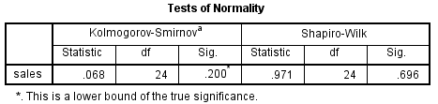
SPSS
2. 분석
(2) Normality
⑤ Kolmogorov-Smirnov & Shapiro-Wilk test on the sales(Q) variable
변경전 변경후
null and alternative hypotheses :
H₀: Normality can be assumed
H₁: Normality can’t be assumed
Interpret :
Interpret :
Shapiro test
D(24) = 0.751, sig = 0.000(<0.05)
This test is significant. Reject H₀.
Conclusion : Sales is not a normal distribution.
K-S test
D(24) = 0.068, sig = 0.200(>0.05)
This test is non-significant. Reject H₀.
Conclusion : Sales is a normal distribution.

Slide 23
SPSS
2. 분석
(2) Normality
⑥ Kolmogorov-Smirnov & Shapiro-Wilk test on the transformed sales(Q) variable
- Transform – Compute Variable

Slide 24
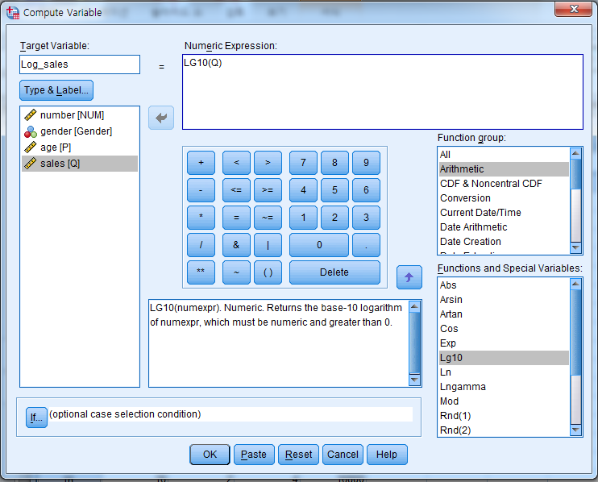
SPSS
2. 분석
(2) Normality
⑥ Kolmogorov-Smirnov & Shapiro-Wilk test on the transformed sales(Q) variable
- Log_sales
- Function group:
-> Arithmetic
Functions and Special Variables:
-> Lg10

Slide 25
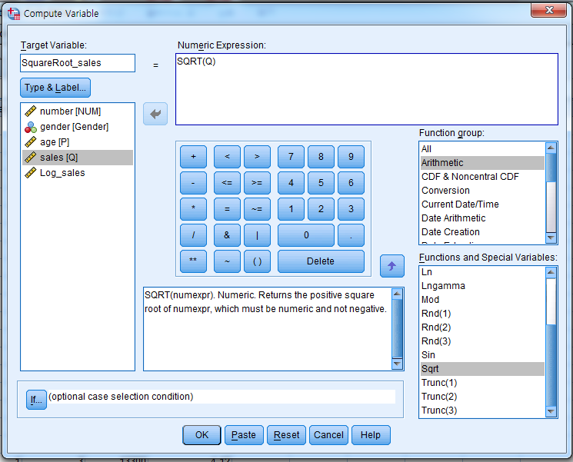
SPSS
2. 분석
(2) Normality
⑥ Kolmogorov-Smirnov & Shapiro-Wilk test on the transformed sales(Q) variable
- SqueareRoot_sales
- Function group:
-> Arithmetic
Functions and Special Variables:
-> Sqrt

Slide 26
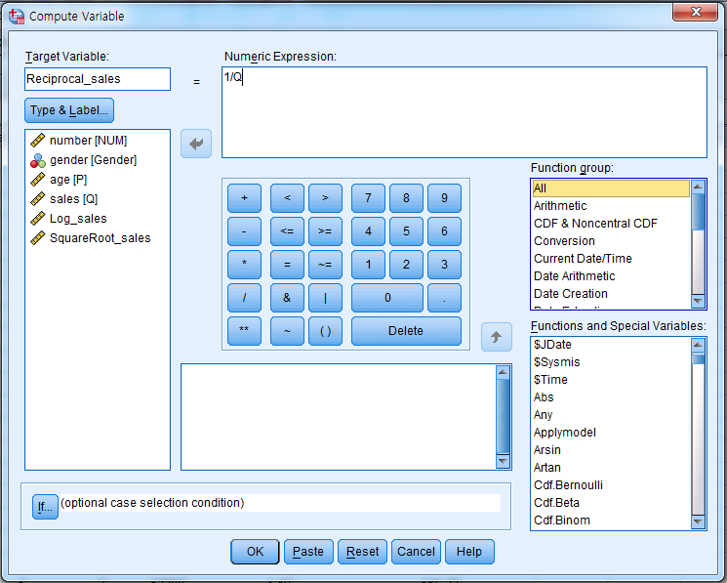
SPSS
2. 분석
(2) Normality
⑥ Kolmogorov-Smirnov & Shapiro-Wilk test on the transformed sales(Q) variable
- Reciprocal_sales

Slide 27
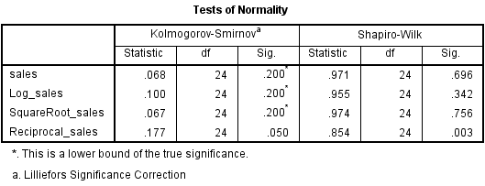
SPSS
2. 분석
(2) Normality
⑥ Kolmogorov-Smirnov & Shapiro-Wilk test on the transformed sales(Q) variable

Slide 28
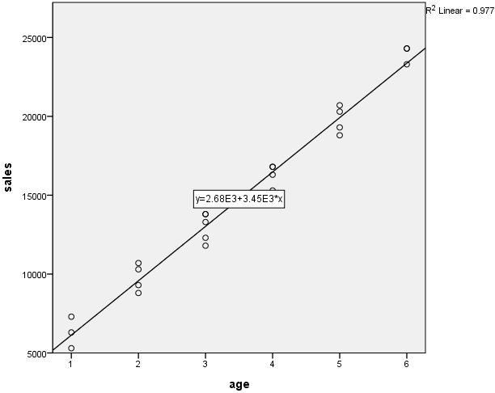
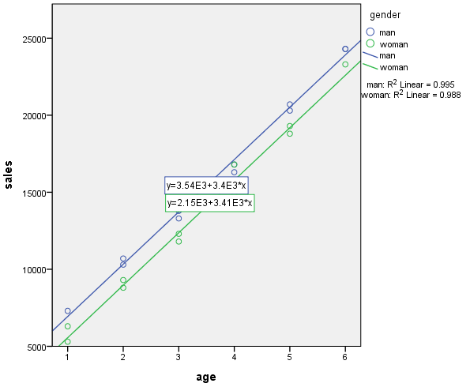
SPSS
2. 분석
(3) Correlation
① Parametric test (Scale-Scale)
Draw Scatterplot(X: P(age), Y: Q(sales)) with the regression line
Graphs - Chart Builder - Scatterplot (그려진 후 scatterplot 더블클릭 후 Add Fit Line at Total 클릭(Grouped Scatterplot인 경우 Add Fit Line at Total Subgroups 클릭))
Scatterplot Grouped Scatterplot (based on the Gender)

Slide 29
SPSS
2. 분석
(3) Correlation
① Parametric test (Scale-Scale)
r²
Coefficient of Determination( )?
=> 0.977

Slide 30
SPSS
2. 분석
(3) Correlation
① Parametric test (Scale-Scale)
Strong Relationship 또는
Moderate Relationship 또는
Week Relationship 또는
No Relationship인지만
알 수 있다.
Positive Relationship 또는
Negative Relationship인지만
알 수 있다.
Interpret : There is a strong positive relationship between age and sales.

Slide 31
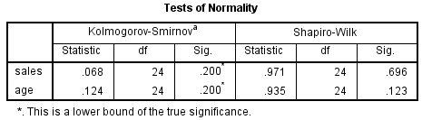
SPSS
2. 분석
(3) Correlation
① Parametric test (Scale-Scale)
Verify that there is a positive relationship between age and sales!
- What is the name of test?
=> Pearson’s Correlation Test! (둘 다 scale data이므로)
- Pearson’s Correlation Test를 돌리기 전에 normality가 전제되어야 한다.
null and alternative hypotheses :
H₀: Normality can be assumed
H₁: Normality can’t be assumed
Interpret :
K-S test about sales
D(24) = 0.068, sig = 0.200(>0.05)
This test is non-significant. Reject H₀.
Conclusion : sales is a normal distribution.
K-S test about age
D(24) = 0.124, sig = 0.200(>0.05)
This test is non-significant. Reject H₀.
Conclusion : age is a normal distribution.

Slide 32
SPSS
2. 분석
(3) Correlation
① Parametric test (Scale-Scale)
Verify that there is a positive relationship between age and sales!
=> Pearson’s Correlation Test! (둘 다 scale data이므로)
- Null and alternative hypotheses
H₀: r = 0
H₁: r > 0
-> one-tail
※ 만약 Scatterplot을 이용해 미리 관계를 보지 않고 Pearson’s Correlation Test의 Null and alternative hypotheses를 세울 경우 지문에
Positive Relationship이 나올 경우 : H₀: r = 0 H₁: r > 0 (one-tail)
Negative Relationship이 나올 경우 : H₀: r = 0 H₁: r < 0 (one-tail)
Relationship이 나올 경우 : H₀: r = 0 H₁: r ≠ 0 (two-tail)

Slide 33
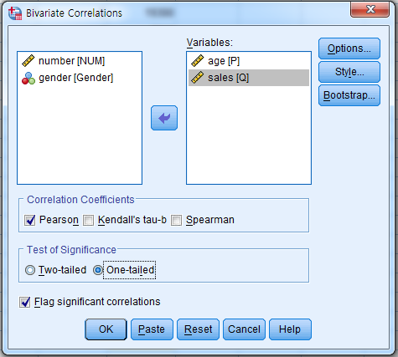
SPSS
2. 분석
(3) Correlation
① Parametric test (Scale-Scale)
Verify that there is a positive relationship between age and sales!
Analyze – Correlate - Bivariate

Slide 34
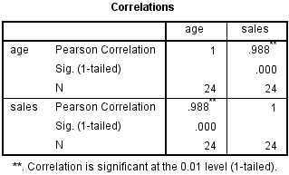
SPSS
2. 분석
(3) Correlation
① Parametric test (Scale-Scale)
Verify that there is a positive relationship between age and sales!
- Null and alternative hypotheses
H₀: r = 0
H₁: r > 0
Interpret :
correlation test
r(24) = 0.988, sig = 0.000(<0.05)
This test is significant.
Reject H₀.
Conclusion : There is a strong positive relationship between age and sales.
각 Test마다 쓰는 기호 다르니
이점 주의할 것!

Slide 35
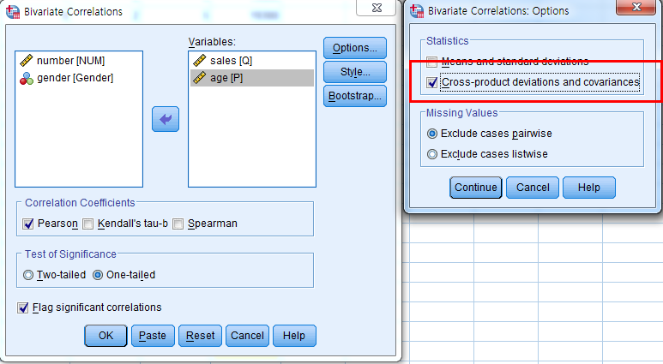
SPSS
2. 분석
(3) Correlation
① Parametric test (Scale-Scale)
covariance between age and sales!
Options – Cross-product deviations and covariances 체크

Slide 36
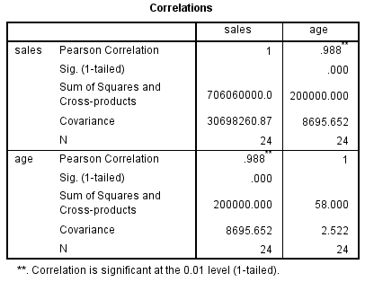
SPSS
2. 분석
(3) Correlation
① Parametric test (Scale-Scale)
covariance between age and sales!
Cov(age,sales)=8695.652

Slide 37
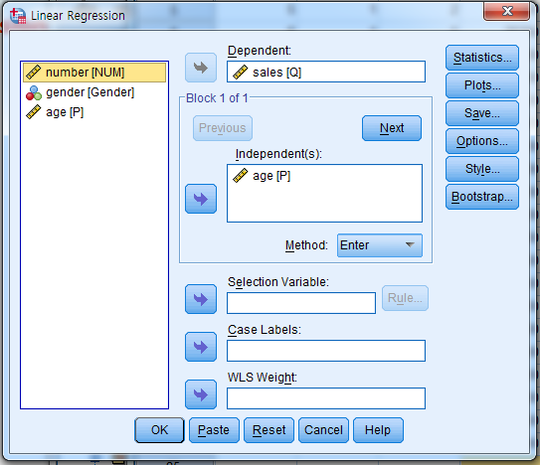
SPSS
2. 분석
(3) Correlation
① Parametric test (Scale-Scale)
Regression for age and sales
Analyze – Regression - Linear
Dependent(y)와 Independent(x)
구분할 줄 알아야 한다.

Slide 38
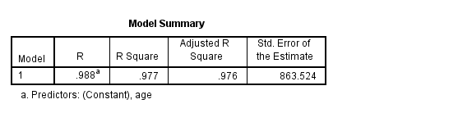
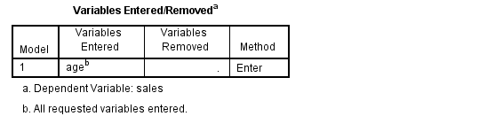
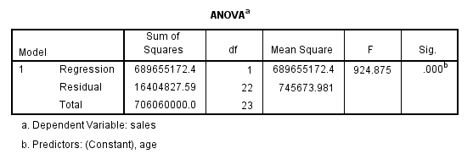
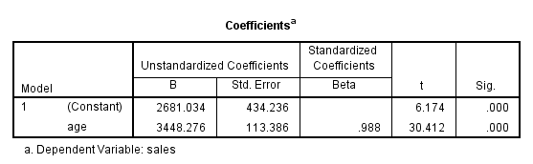
SPSS
2. 분석
(3) Correlation
① Parametric test (Scale-Scale)
Regression for age and sales
Coefficient of Determination( )?
r²
=> 0.977

Slide 39
SPSS
2. 분석
(3) Correlation
① Parametric test (Scale-Scale)
Regression for age and sales
Y = b0 + b1·X (Y: outcome(dependent), b0: constant, b1: coefficient for X,
X: predictor(independent))
Sales = 2681.034 + 3448.276(age)
- age가 얼마일 때 sales 값을 구하라
- sales가 얼마일 때 age 값을 구하라
답만 적지 말고 반드시 풀이 과정 적을 것!

Slide 40
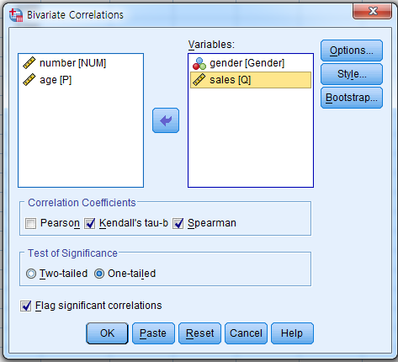
SPSS
2. 분석
(3) Correlation
② Nonparametric test (Scale - Ordinal/Nominal)
Is there negative relationship(one-tail) between sales and gender?
Analyze – Correlate - Bivariate
- What is the name of test?
Kendall’s tau-b Test!
Spearman Test!

Slide 41
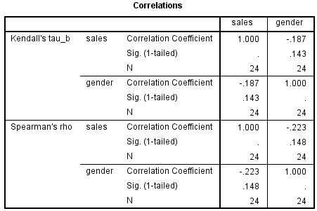

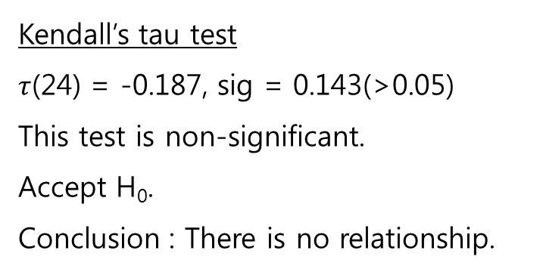
SPSS
2. 분석
(3) Correlation
② Nonparametric test (Scale - Ordinal/Nominal)
Is there negative relationship(one-tail) between sales and gender?
- Null and alternative hypotheses
H₀: $τ$ = 0
H₁: $τ$ < 0
Interpret :
Kendall’s tau test
$τ$(24) = -0.187, sig = 0.143(>0.05)
This test is non-significant.
Accept H₀.
Conclusion : There is no relationship.
small data는 Kendall’s tau test를 쓴다.
small data 유무는 문제에 명시된다.

Slide 42
SPSS
2. 분석
(3) Correlation
② Nonparametric test (Scale - Ordinal/Nominal)
Is there negative relationship between sales and gender?
- Null and alternative hypotheses
H₀: r_{s}= 0
H₁: r_{s}< 0
Interpret :
Spearman’s rho test
r_{s}(24) = -0.223, sig = 0.148(>0.05)
This test is non-significant.
Accept H₀.
Conclusion : There is no relationship.
각 Test마다 쓰는 기호 다르니
이점 주의할 것!

Slide 43
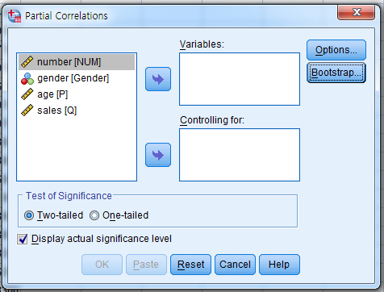
SPSS
2. 분석
(3) Correlation
③ Partial Correlation test
Analyze – Correlate - Partial
각 Test마다 쓰는 기호 다르니
이점 주의할 것!
Scale 데이터 하나가 부족하므로 여기서는 스킵, Practical 5 Part B 풀어 볼 것!
지문을 읽고 Variables와 controlling에 넣어야 할 변수를 확실히 구별할 줄 알아야 한다.

Slide 44
SPSS
2. 분석
(4) Homogeneity of Variance
Check the homogeneity of variance for sales(Q) (grouped by gender)
- What is the name of test?
Levene’s Test!

Slide 45
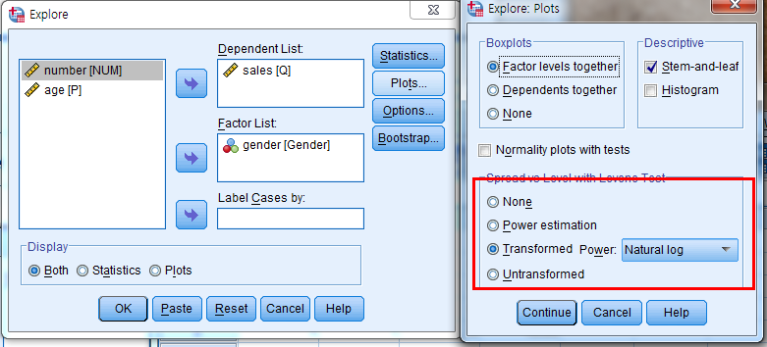
SPSS
2. 분석
(4) Homogeneity of Variance
Analyze - Descriptive Statistics - Explore
Plots - Transformed Power(Natural log) 체크

Slide 46
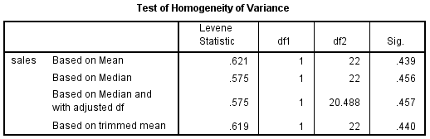
SPSS
2. 분석
(4) Homogeneity of Variance
null and alternative hypotheses :
H₀: Homogeneity of variance can be assumed
H₁: Homogeneity of variance can’t be assumed
Interpret :
Levene’s test
F(1,22) = 0.621, sig = 0.439(>0.05)
This test is non-significant.
Accept H₀.
Conclusion : The variances is about the same in different groups
각 Test마다 쓰는 기호 다르니
이점 주의할 것!

Slide 47
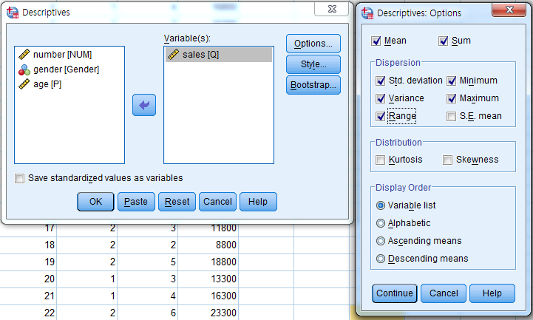

SPSS
2. 분석
(5) range, min, max, sum, mean, standard deviation, variance (In Practical2 Part B)
- Analyze - Descriptive Statistics - Descriptives
Mean, Sum, Std. deviation, Minimum, Variance, Maximum, Range 체크

Slide 48
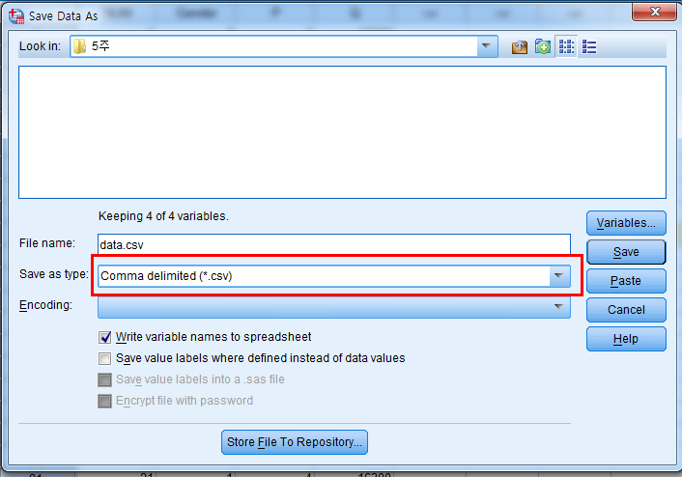
SPSS
3. 저장
(1) CSV 파일로 저장
File - Save As
Save as type을 Comma delimited(*.csv)로 변경

Slide 49

R 프로그램
1. 데이터 입력
(1) 직접 입력
- What is the command used to input data into the R Program in “x”?
x<-c(2,2.5,3.5,7.89,5,6.1,54,2.3,5.2,4.4) or x=c(2,2.5,3.5,7.89,5,6.1,54,2.3,5.2,4.4)
- “y” is 50% of the “x”.
What is the command used to input the “y” data into the R Program ?
y = 0.5 * x
- What are the values for “y”?
※ 명령어를 몰라 SPSS로 입력, 계산할 시 소수점 표기가 다르기 때문에 소용없다.

Slide 50
R 프로그램
1. 데이터 입력
(2) Random Number
What is the command used to input random data into the R Program?
z<-sample(1:1000,size=100)
범위 개수
m<-sample(1:1000,size=1001)
-> error
m<-sample(1:1000,size=1001,replace=T)

Slide 51
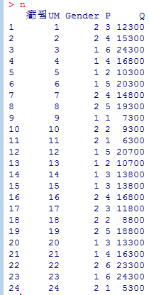
R 프로그램
1. 데이터 입력
(3) .CSV read
What is the command used to read .csv file data into the R Program?
n<-read.csv(file=“C:/…/…/data.csv”)
‘/’ 방향 주의해야 한다!
※ 명령어를 몰라 SPSS로 입력, 계산할 시 소수점 표기가 다르기 때문에 소용없다.

Slide 52
R 프로그램
2. 분석
(1) Max, Min, 1st · 2nd · 3rd Quartile, Average(Mean), Standard Deviation, Variance, Range
What is the values and command used to get values for ‘Q’ of ‘n’ data?
- Name(n) :
- Max :
- Min :
- 1st Quartile :
- 2nd Quartile(Median) :
- 3rd Quartile :
- Average(Mean) :
24300 max(n$Q) 또는 max(n[,4])
summary(n$Q) 또는 summary(n[,4])
5300 min(n$Q) 또는 min(n[,4])
10600
quantile(n$Q,probs=c(0.25)) 또는 quantile(n[,4],probs=c(0.25))
14300 median(n$Q) 또는 median(n[,4]) 또는 quantile(n$Q,probs=c(0.5)) 또는 quantile(n[,4],probs=c(0.5))
18925
quantile(n$Q,probs=c(0.75)) 또는 quantile(n[,4],probs=c(0.75))
14750 mean(n$Q) 또는 mean(n[,4])

Slide 53

R 프로그램
2. 분석
(1) Max, Min, 1st · 2nd · 3rd Quartile, Average(Mean), Standard Deviation, Variance, Range
What is the values and command used to get values for ‘Q’ of ‘n’ data?
- Standard Deviation :
- Variance :
- Range :
5540.601 sd(n$Q) 또는 sd(n[,4])
30698261 var(n$Q) 또는 var(n[,4])
19000 max(n$Q)-min(n$Q) 또는 max(n[,4])-min(n[,4])
- For문 예제
range(n$Q) 또는 range(n[,4])
※ ‘변수이름[행,열]’을 잘 생각하여 계산해야 한다.
명령어를 몰라 SPSS로 입력, 계산할 시 소수점 표기가 다르기 때문에 소용없다.

Slide 54

R 프로그램
2. 분석
(2) Graph
Draw histogram for ‘Q’ of ‘n’ data?
hist(n$Q) 또는 hist(n[,4])

Slide 55

R 프로그램
2. 분석
(2) Graph
Draw boxplot for ‘Q’ of ‘n’ data?
boxplot(n$Q) 또는 boxplot(n[,4])
max(24300)
2nd Quartile(Median)(14300)
min(530)

Slide 56

R 프로그램
2. 분석
(2) Graph
Draw scatterplot for ‘P’ and ‘Q’ of ‘n’ data with a regression line?
plot(n$P,n$Q) 또는 plot(n[,3],n[,4])
abline(lm(n$Q~n$P),col=“red”)
또는
abline(lm(n[,4]~n[,3]),col=“red”)
lm 함수는 x축, y축이 바뀌며
‘,’(콤마)대신 ‘~’(물결표)를 쓴다는 점을
조심할 것!

Slide 57


R 프로그램
2. 분석
(3) Correlation
Compute covariance and Pearson’s correlation coefficient for ‘P’ and ‘Q’ of ‘n’ data?
cov(n$P,n$Q) 또는 cov(n[,3],n[,4])
Cov(age,sales) = 8695.652 -> SPSS 결과와 비교
cor(n$P,n$Q) 또는 cor(n[,3],n[,4])
r(24) = 0.988 -> SPSS 결과와 비교

Slide 58

R 프로그램
2. 분석
(3) Correlation
Determine the regression equation for ‘P’ and ‘Q’ of ‘n’ data?
lm(n$Q~n$P) 또는 lm(n[,4]~n[,3])
Q(Sales) = 2681 + 3448(P(age))
Sales = 2681.034 + 3448.276(age) -> SPSS 결과와 비교

Slide 59

R 프로그램
2. 분석
(3) Correlation
Compute and interpret the coefficient of determination( ) for ‘P’ and ‘Q’ of ‘n’ data?
r²
summary(lm(n$Q~n$P)) 또는 summary(lm(n[,4]~n[,3]))
Multiple R-squared
0.9768
SPSS 결과 : 0.977

Slide 60

R 프로그램
2. 분석
(3) Correlation
Perform Pearson, Spearman and Kendall test for ‘P’ and ‘Q’ of ‘n’ data?
cor.test(n$P,n$Q) 또는 cor.test(n[,3],n[,4])
Pearson :

Slide 61

R 프로그램
2. 분석
(3) Correlation
Perform Pearson, Spearman and Kendall test for ‘P’ and ‘Q’ of ‘n’ data?
Spearman :
cor.test(n$P,n$Q,method=“spearman”)
또는 cor.test(n[,3],n[,4], method=“spearman”)

Slide 62

R 프로그램
2. 분석
(3) Correlation
Perform Pearson, Spearman and Kendall test for ‘P’ and ‘Q’ of ‘n’ data?
Kendall :
cor.test(n$P,n$Q,method=“kendal”)
또는 cor.test(n[,3],n[,4], method=“kendal”)

Slide 63
마무리
※ 가장 좋은 시험 공부 방법은?
지금까지 풀어왔던 실습지의 답을 지우고
익숙해질 때까지 계속 풀어본다!

